Slide 1
Explanation of Claim Payments (EOP)
Web-based Reporting System
for
Maryland Core Service Agencies (CSAs)
Qiang (John) Qian MS, MD
HaoHan Technologies, LLC
November 1, 2012

Slide 2
“Data Everywhere,
Analysis Nowhere.”
-----From a leadership of DHMH

Slide 3
“Low Cost,
High Performance.”
“To be small health care agencies’ Data Helper”
-----HaoHan Technologies. LLC

Slide 4
Goals
1. Through this System, CSAs will be able to analyse existing EOP data to
know population with behavior health problems,
summarize and review behavior health service utilization information at CSA , provider and consumer levels.

Slide 5
Goals
create reports for any concerned variables or their combination
prepare CSA annual plan
prepare grant application
prepare CSA data training
select target population for certain researches

Slide 6
Goals
2. Low-cost, High Performance
3. Easy-use, Intuitive, User-friendly
4. Can be easy to be extended

Slide 7
Claim EOP Data
20 Data Variables Available to CSAs:
1. Consumer Name | 6. Age Group*
2. Consumer ID | 7. Sex Code*
3. Claim TCN | 8. Race Code*
4. Claim Line Number | 9. Eligibility Category*
5. Age* | 10. Service Category*
*: analytic variable

Slide 8
Claim EOP Data
11. Service Date* | 17. Units of Service*
12. Date Paid* | 18. Net Payment*
13. Service Vendor* | 19. Pay to Vendor*
14. Provider Name | 20. CPT/Revenue Code*
15. Procedure Code Modifier*
16. CSA Name
*: analytic variable

Slide 9
Key Capabilities
All analytic data variables are included in the analysis
Remind user of downloading and uploading EOP data (weekly based).
Upload EOP data
Check and eliminate duplicates.
Search consumer with service dates, service category and provider.

Slide 10
Key Capabilities
Generate aggregation repots
Sort results
Find service utilization outliers.
Present with chart/graph
Drill down
Aggregation Report at county/provider
Aggregation Report at consumer
Claim
Claim Line
Claim detail information

Slide 11
Key Capabilities
Generate cross tabulation reports with age group, sex, race, eligibility, service category based on consumer count, expenditure, units and visits.
Entry and edition functions (unnecessary for this system, but they are essential for a complete EMR system)
Website Administration

Slide 12
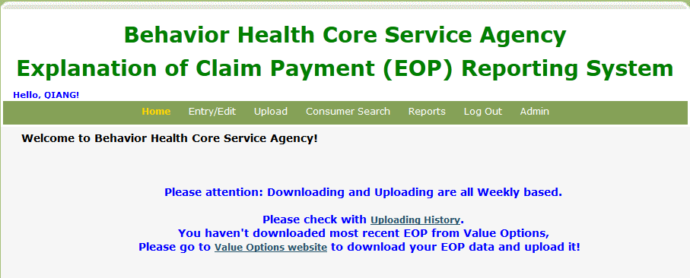
1. Remind of downloading data.
Please check with Uploading History

Slide 13
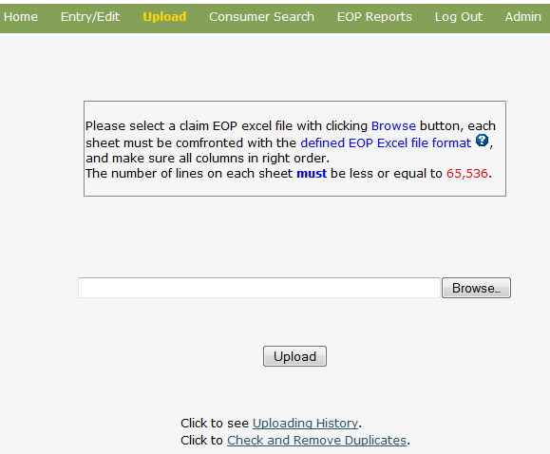
2. Uploading
Click to see Uploading History
Click to check and remove duplicates

Slide 14
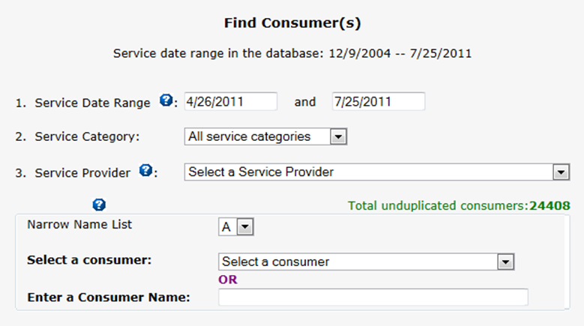
3. Consumer Search

Slide 15
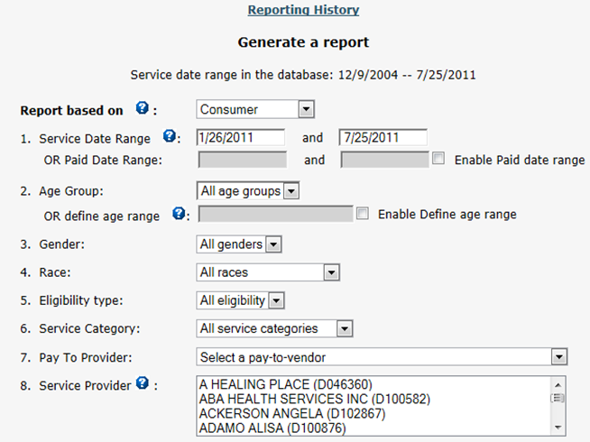
4. Basic Reports
Reporting History

Slide 16
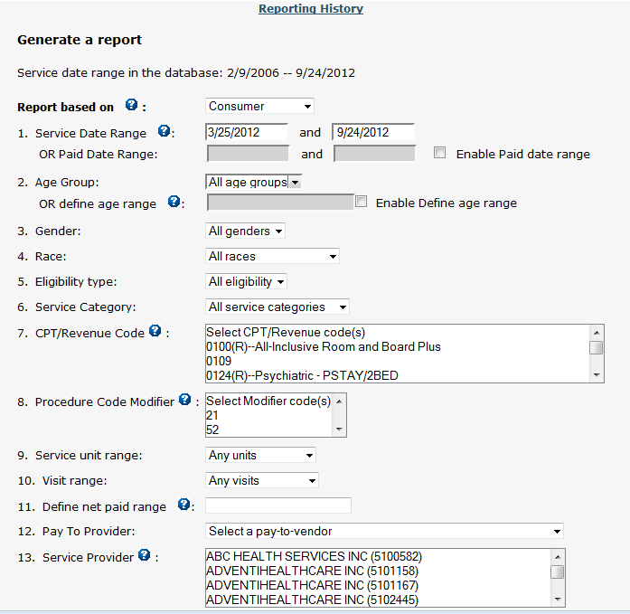
5. Advanced Reports
Reporting History

Slide 17
6.1 Report Output 1
Output in HTML
Output in Excel

Slide 18
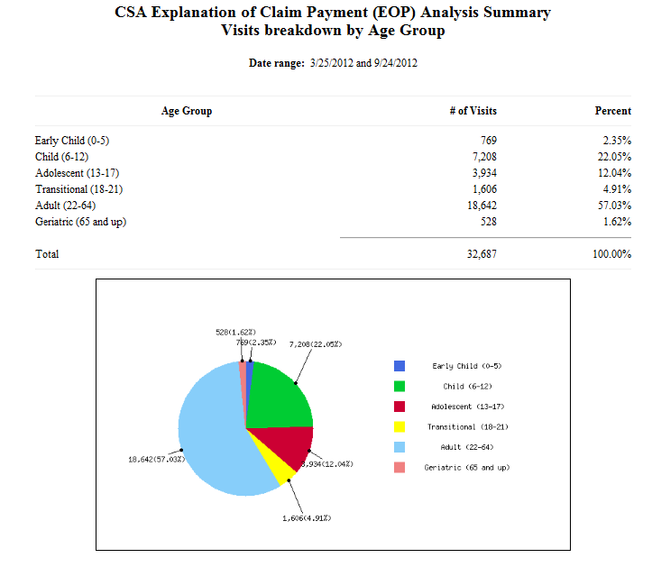
6.2 Report Output 2

Slide 19
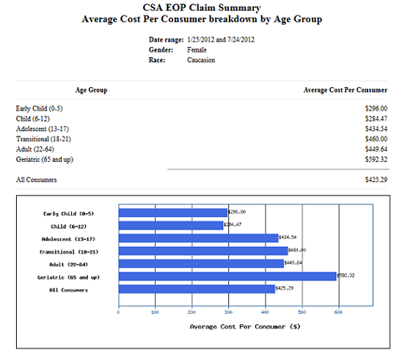
6.3 Report Output 3

Slide 20
6.4 Report Output 4
Output in HTML
Output in Excel

Slide 21
6.5 Report Output 5
Output in HTML
Output in Excel

Slide 22
6.6 Report Output 6
Output in HTML
Output in Excel

Slide 23
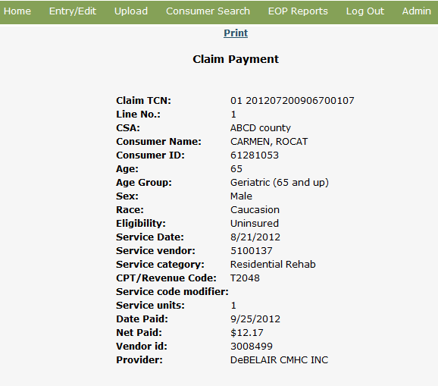
6.7 Report Output 7

Slide 24
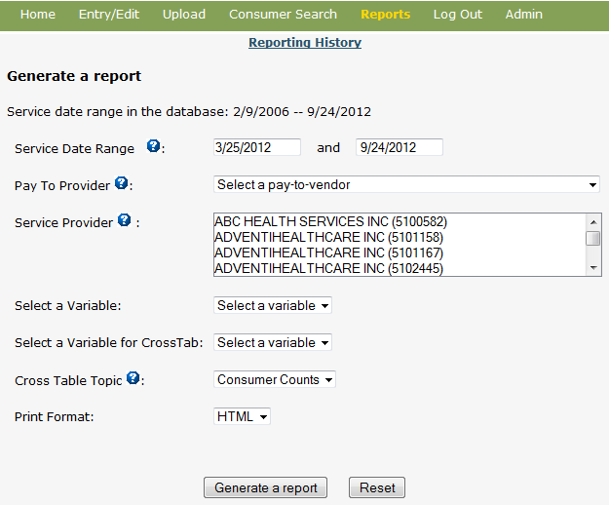
7. Cross Tabulation Report
Reporting History
Output Format

Slide 25
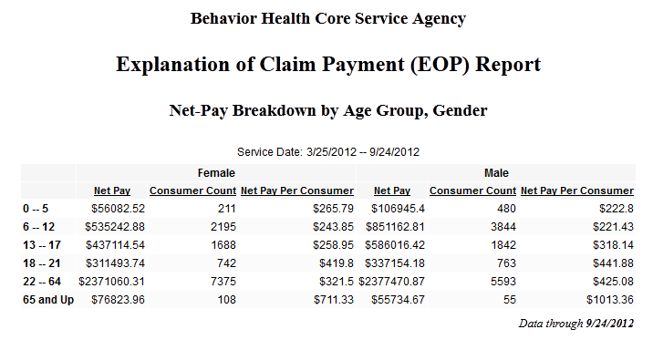
8. Cross Tabulation Report Output

Slide 26
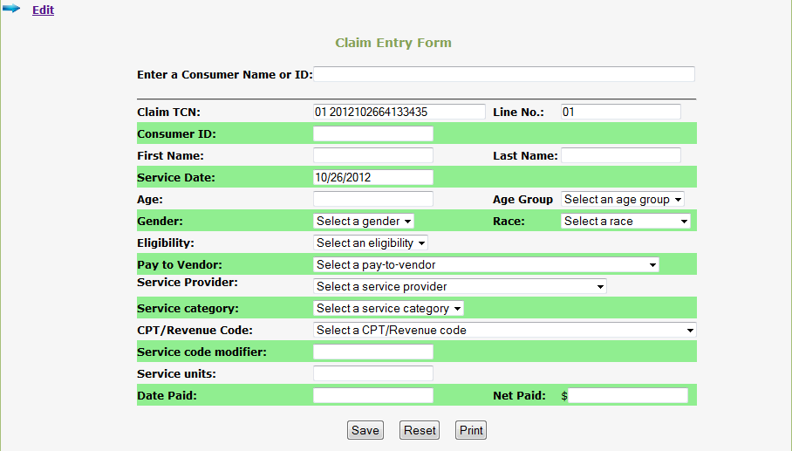
9. Entry

Slide 27
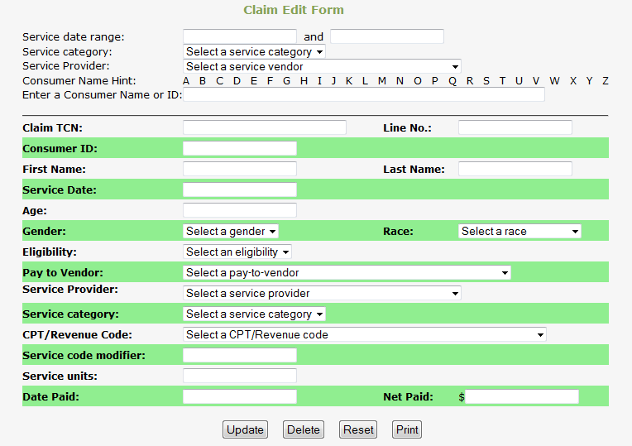
10. Edit

Slide 28
System Features
The web-based reporting system:
has 2 versions based on database type: MS Access database (install on desktop) and SQL server database (remote access).
works on Internet Explorer, Firefox, and Chrome browsers.
can be further modified and expanded to meet any emerging needs at state, county and provider levels.

Slide 29
Some Ongoing Projects
Johns Hopkins University Pediatric HIV Data Collection & Reporting System (https://orchid.hosts.jhmi.edu/ipccohort/login.asp)
Pelvic Inflammatory Disease (PID) Research Surveys (https://orchid.hosts.jhmi.edu/pidresearch/index.asp)
Paper: Trent M, Lehmann HP, Qian Q, Thompson CB, Ellen JM, Frick KD. Adolescent and parental utilities for the health states associated with pelvic inflammatory disease. Sex Transm Infect. 2011 Oct 14
Johns Hopkins University Adult HIV Service Substance Abuse Program – Narco Tracker (https://orchid.hosts.jhmi.edu/narcotracker/login.aspx)
Johns Hopkins University Adult HIV Service Ryan White Program Electronic Medical Record (EMR) system and Client Level Data reporting system (since 2004)

Slide 30
Demonstration
Go to the website

Slide 31
Contact Information
HaoHan Technologies, LLC
Qiang (John) Qian MS, MD
Cell:443-421-2744
Email: qianqchn@yahoo.com
Website: http://www.hhtdata.com

Slide 32
Thank You!

